Slide 1
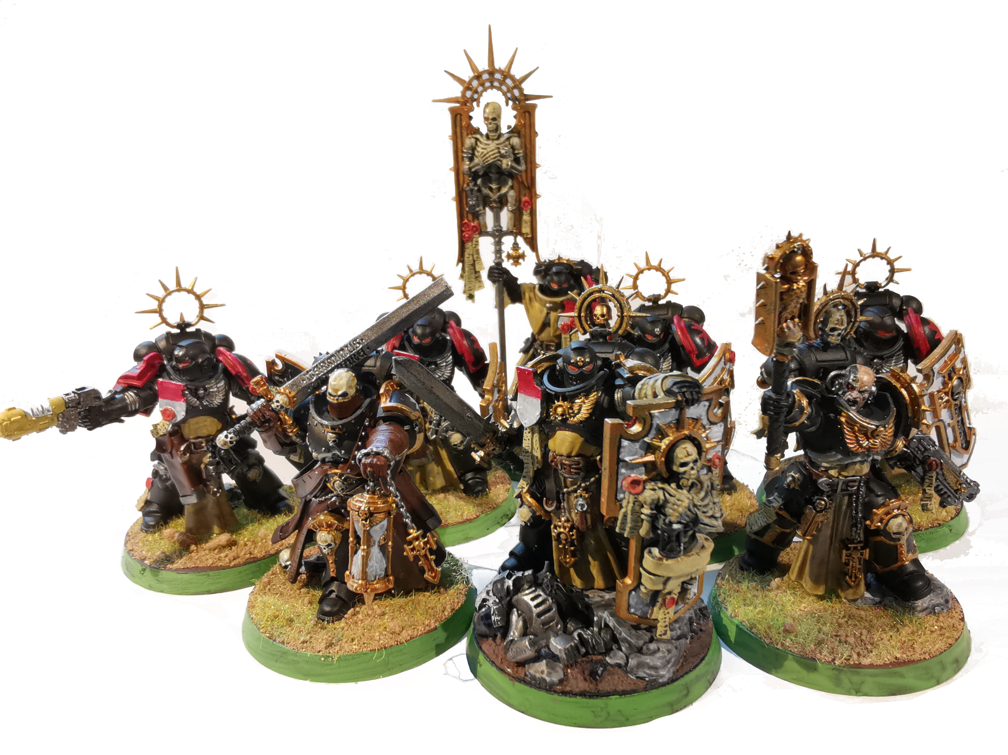
Rediscovering Painting Angry Spacemen
Notes:
20 Minutes
3 - Intro
3 - Building
3 – Painting
3 - Playing
3 – Benefits
5 – Questions
WHO AM I

Slide 2
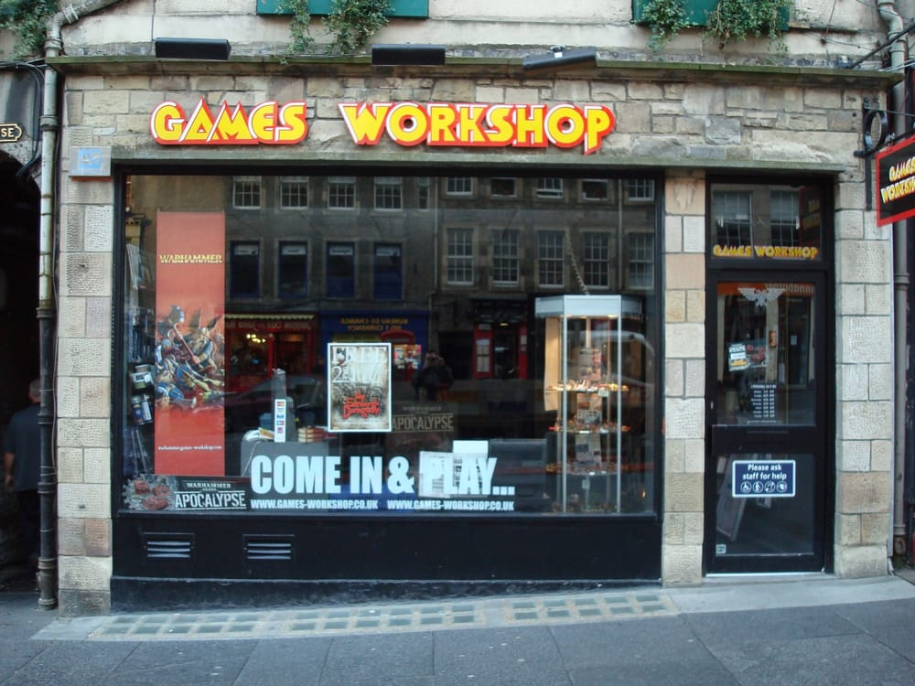
When I was a boy..
Notes:
17 years ago

Slide 3
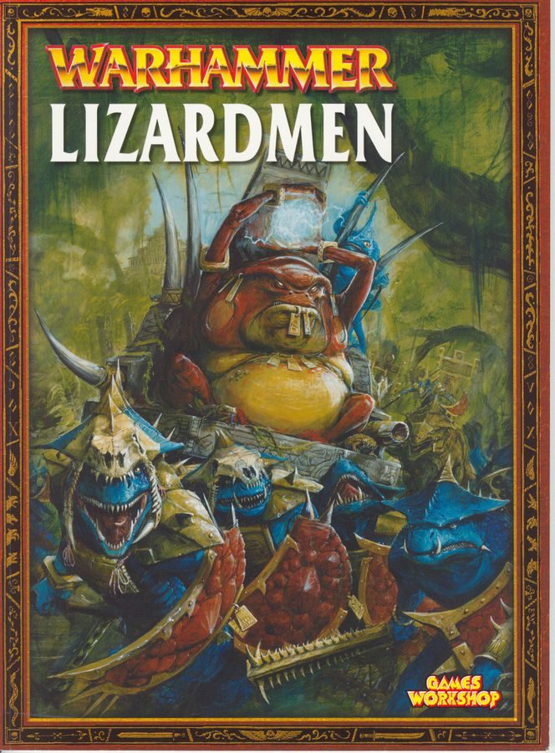
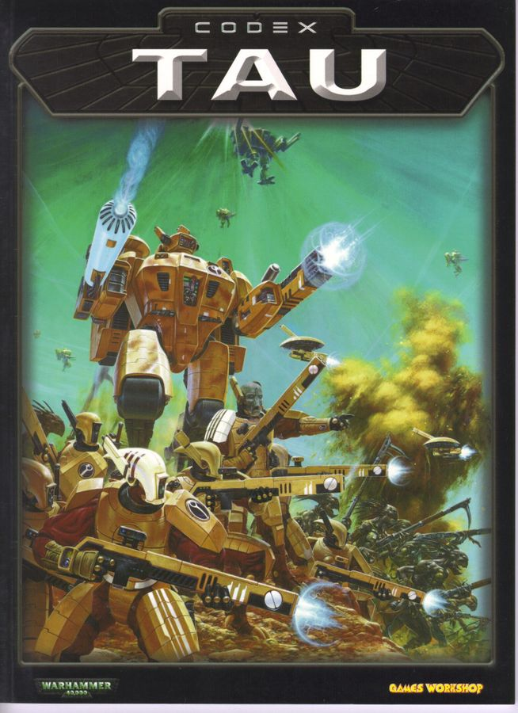
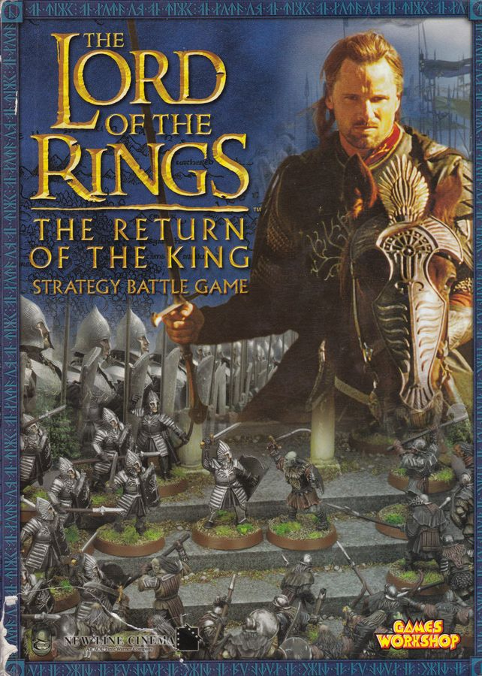
When I was a boy..
Notes:
3 games
Warhammer Fantasy
Warhammer 40,000
Lord of the Rings
Tabletop Strategy Wargames
Build models, create an army, throw a lot of dice and make copious use of measuring tapes

Slide 4
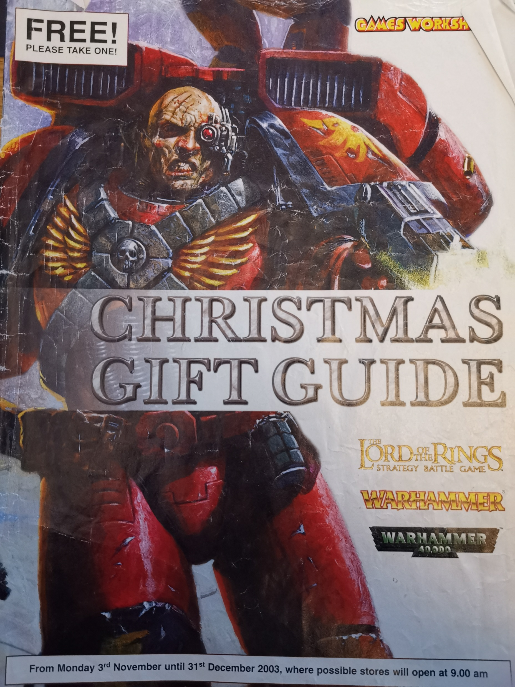
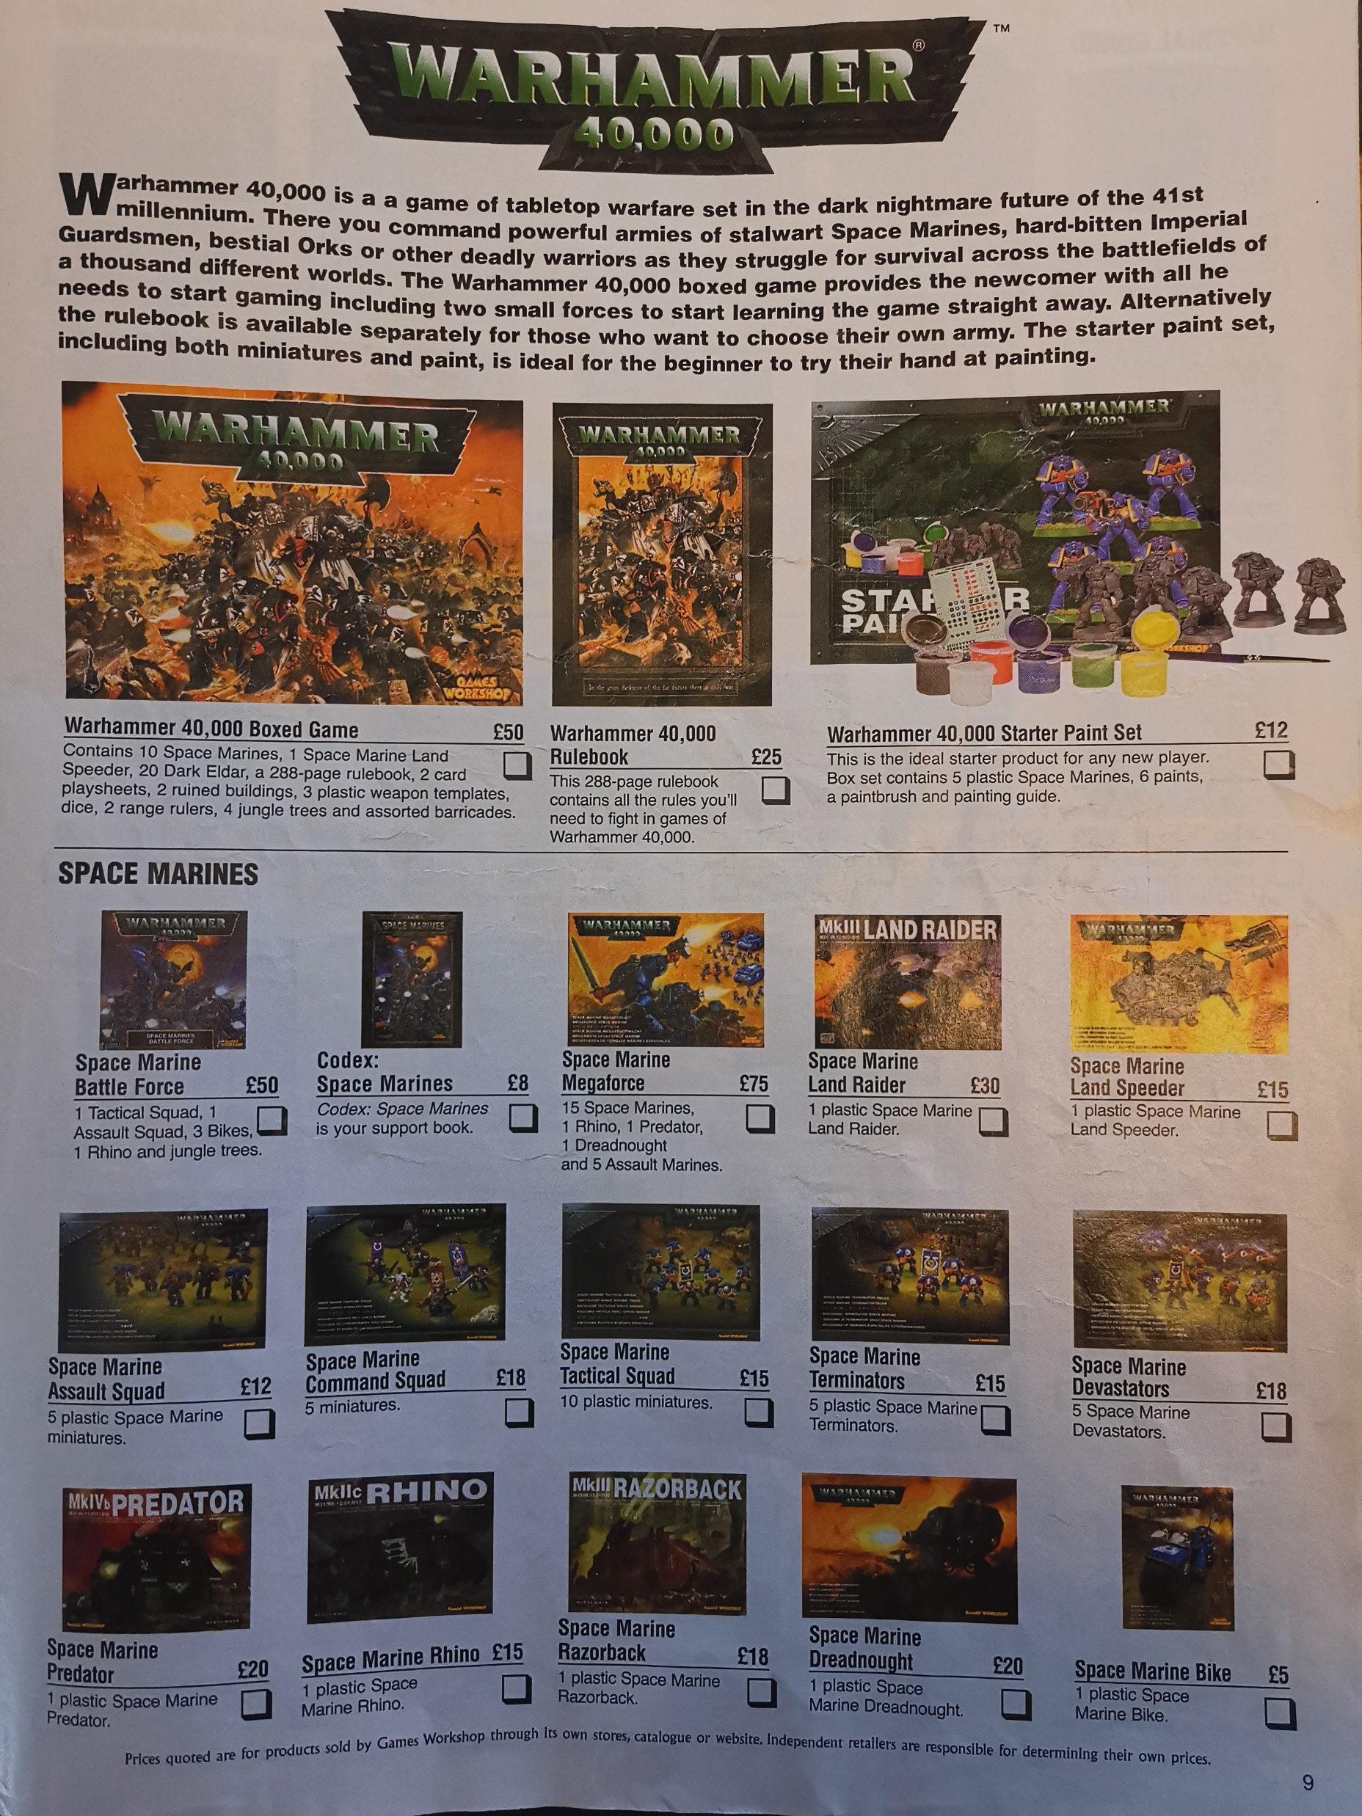
When I was a boy..

Slide 5
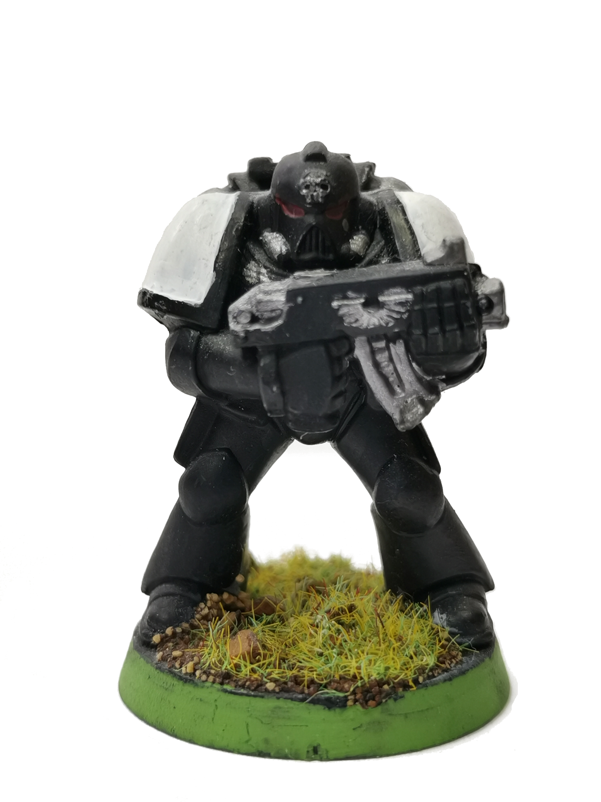
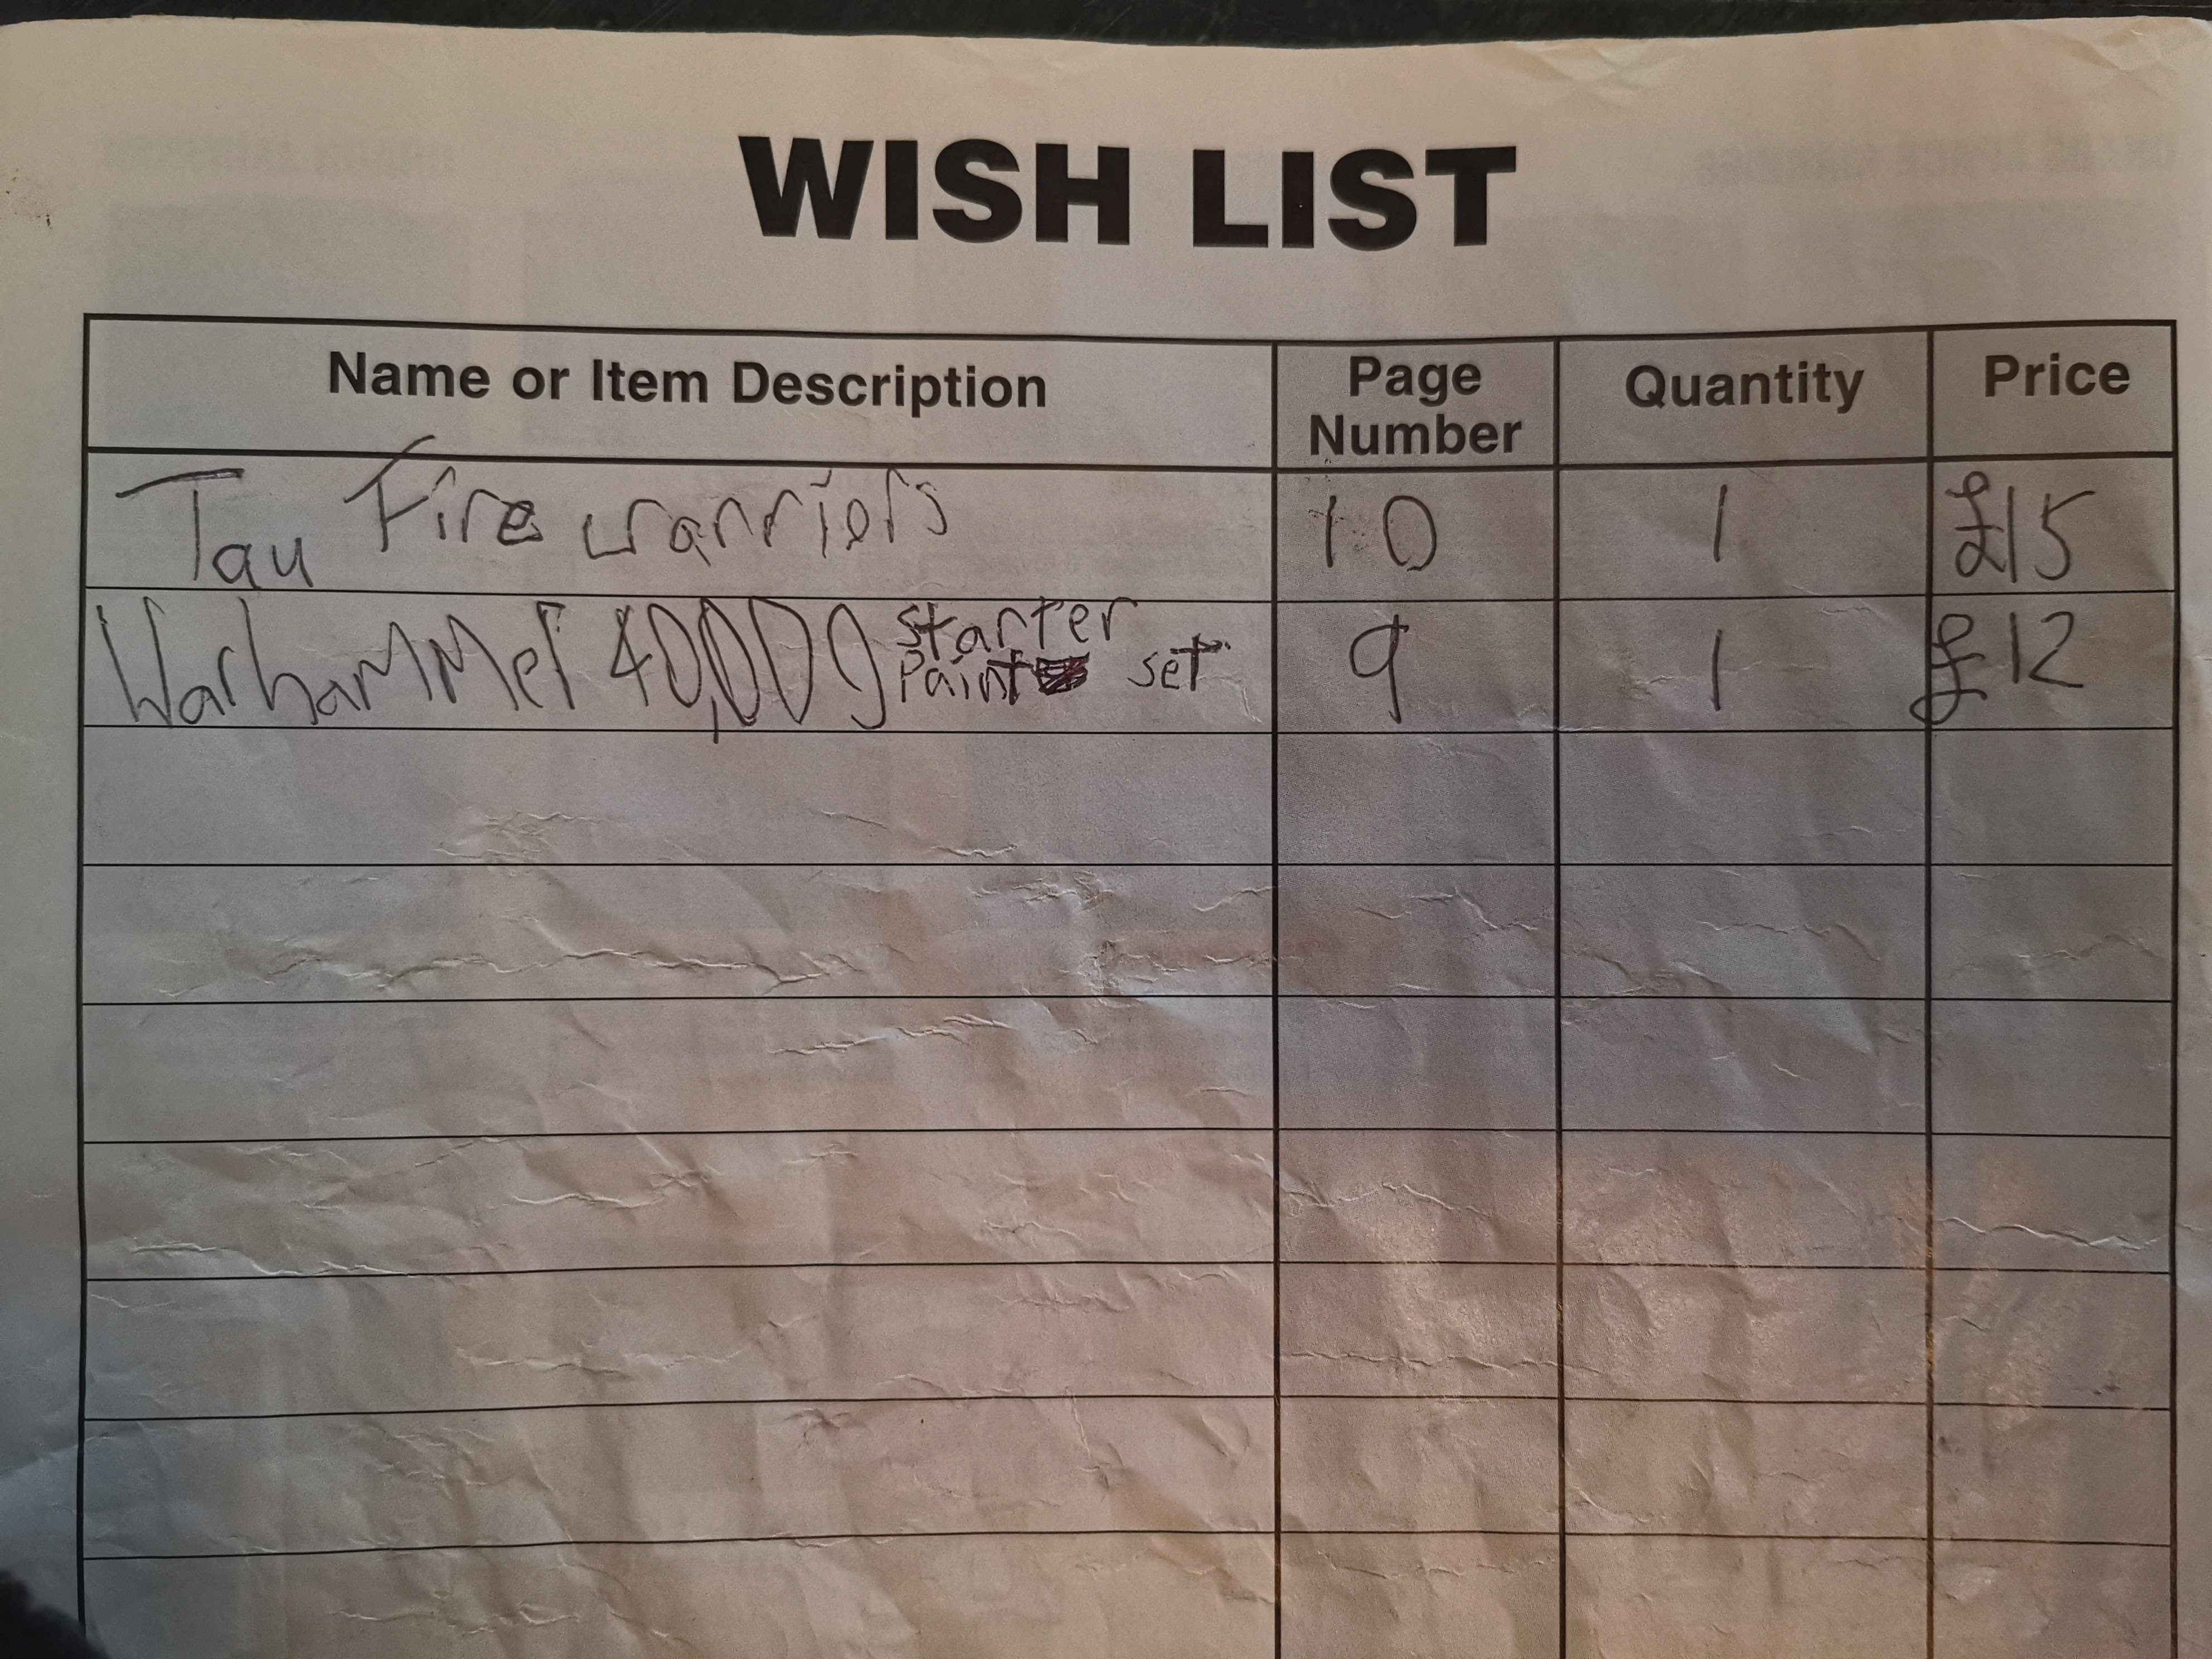
When I was a boy..
Notes:
Wishlist
Over the years collected a few sets of models, never actually played the game (too much measuring, didn’t know anyone else playing)
University happened

Slide 6
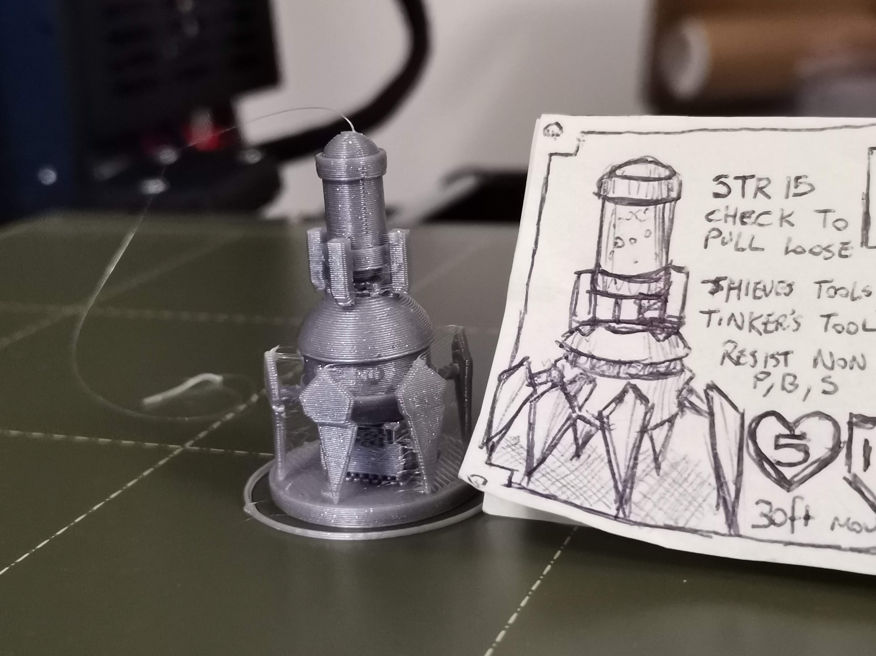
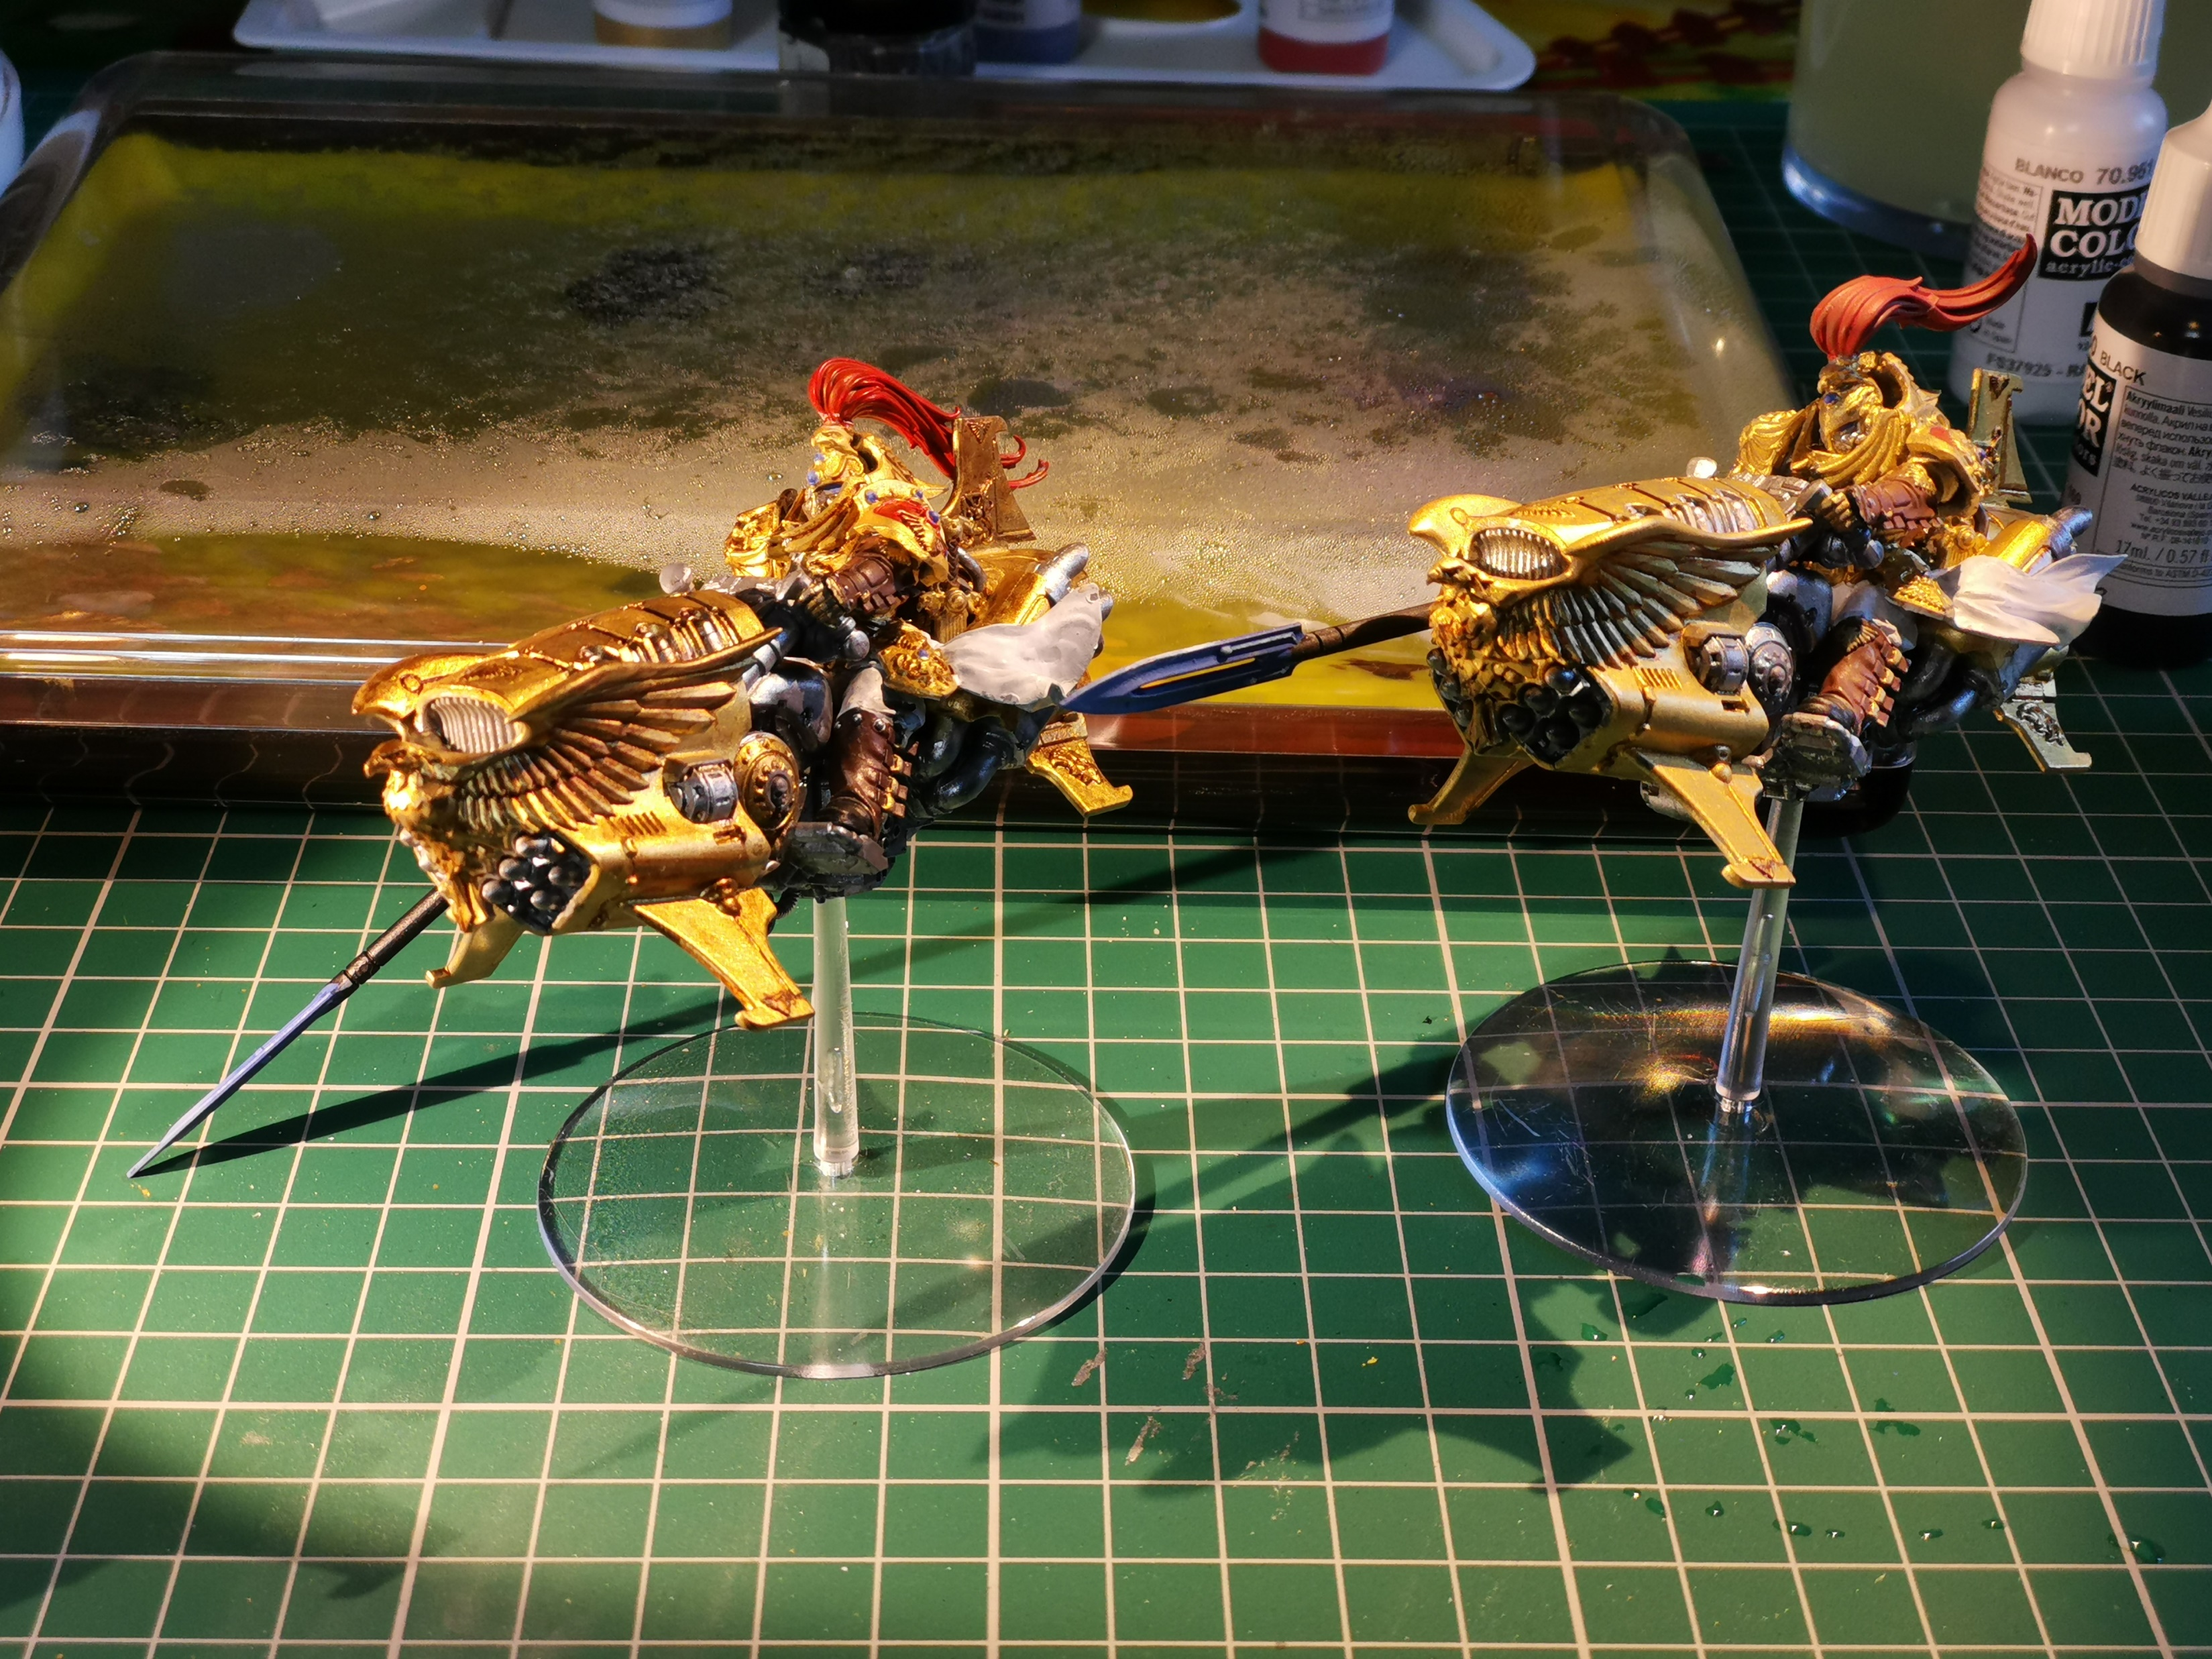
DnD, The Youtube Algorithm, and a Pandemic
Notes:
Big nerd,
Also play DnD
3d Printing
How to paint?
Videos are dangerous – seeing a lot of Warhammer again..
Pandemic!
Just one box…

Slide 7
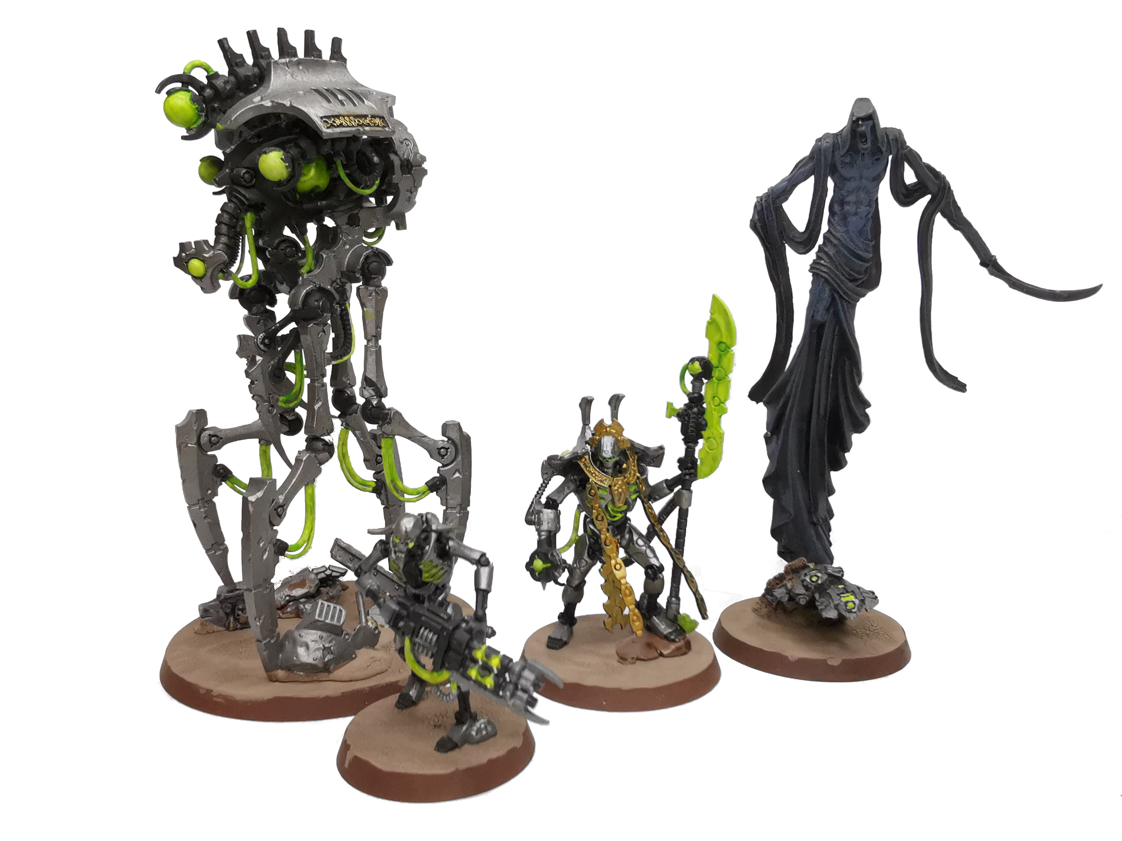
Back with a Vengeance

Slide 8
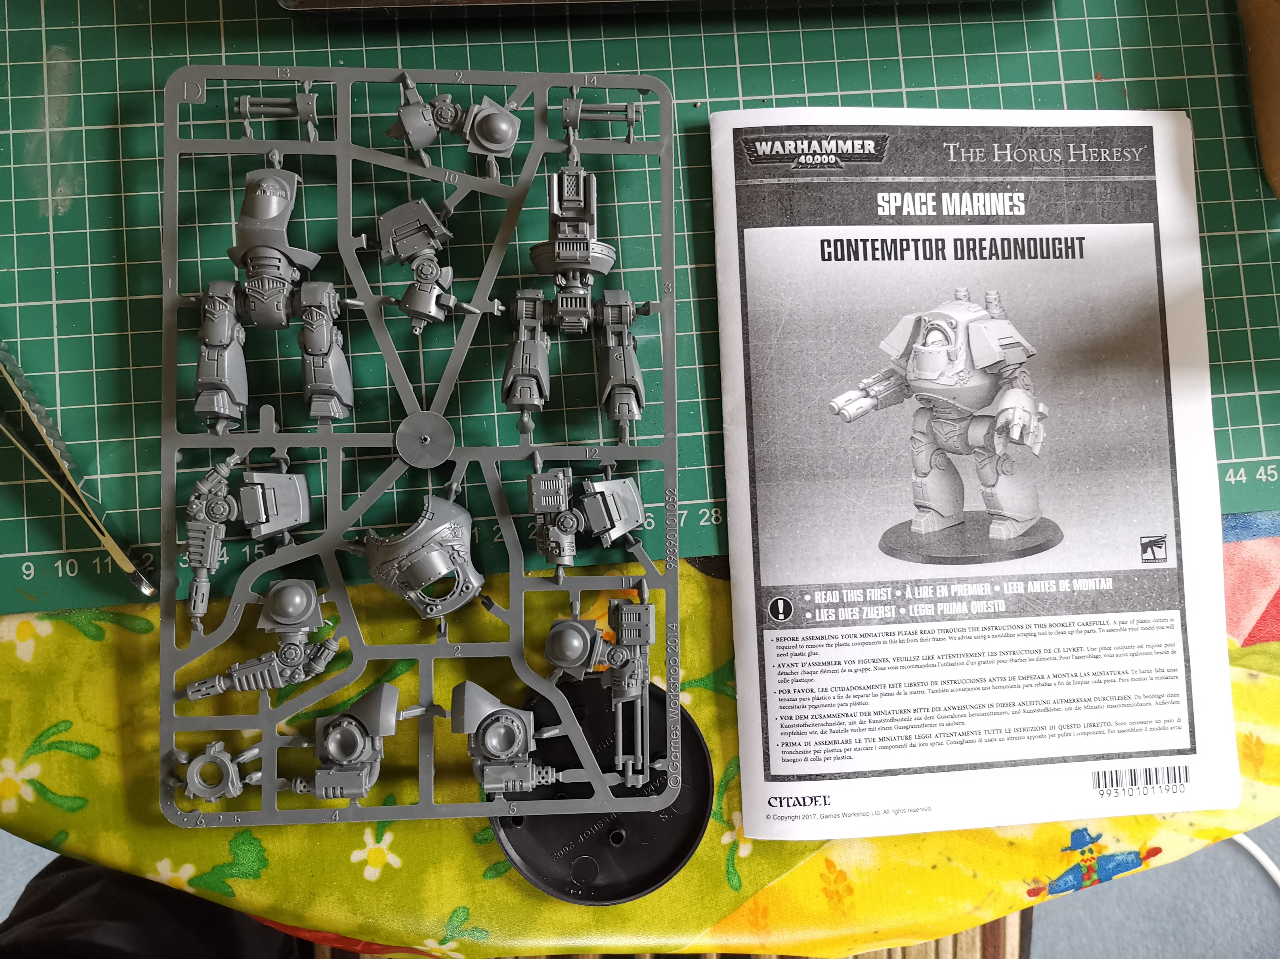
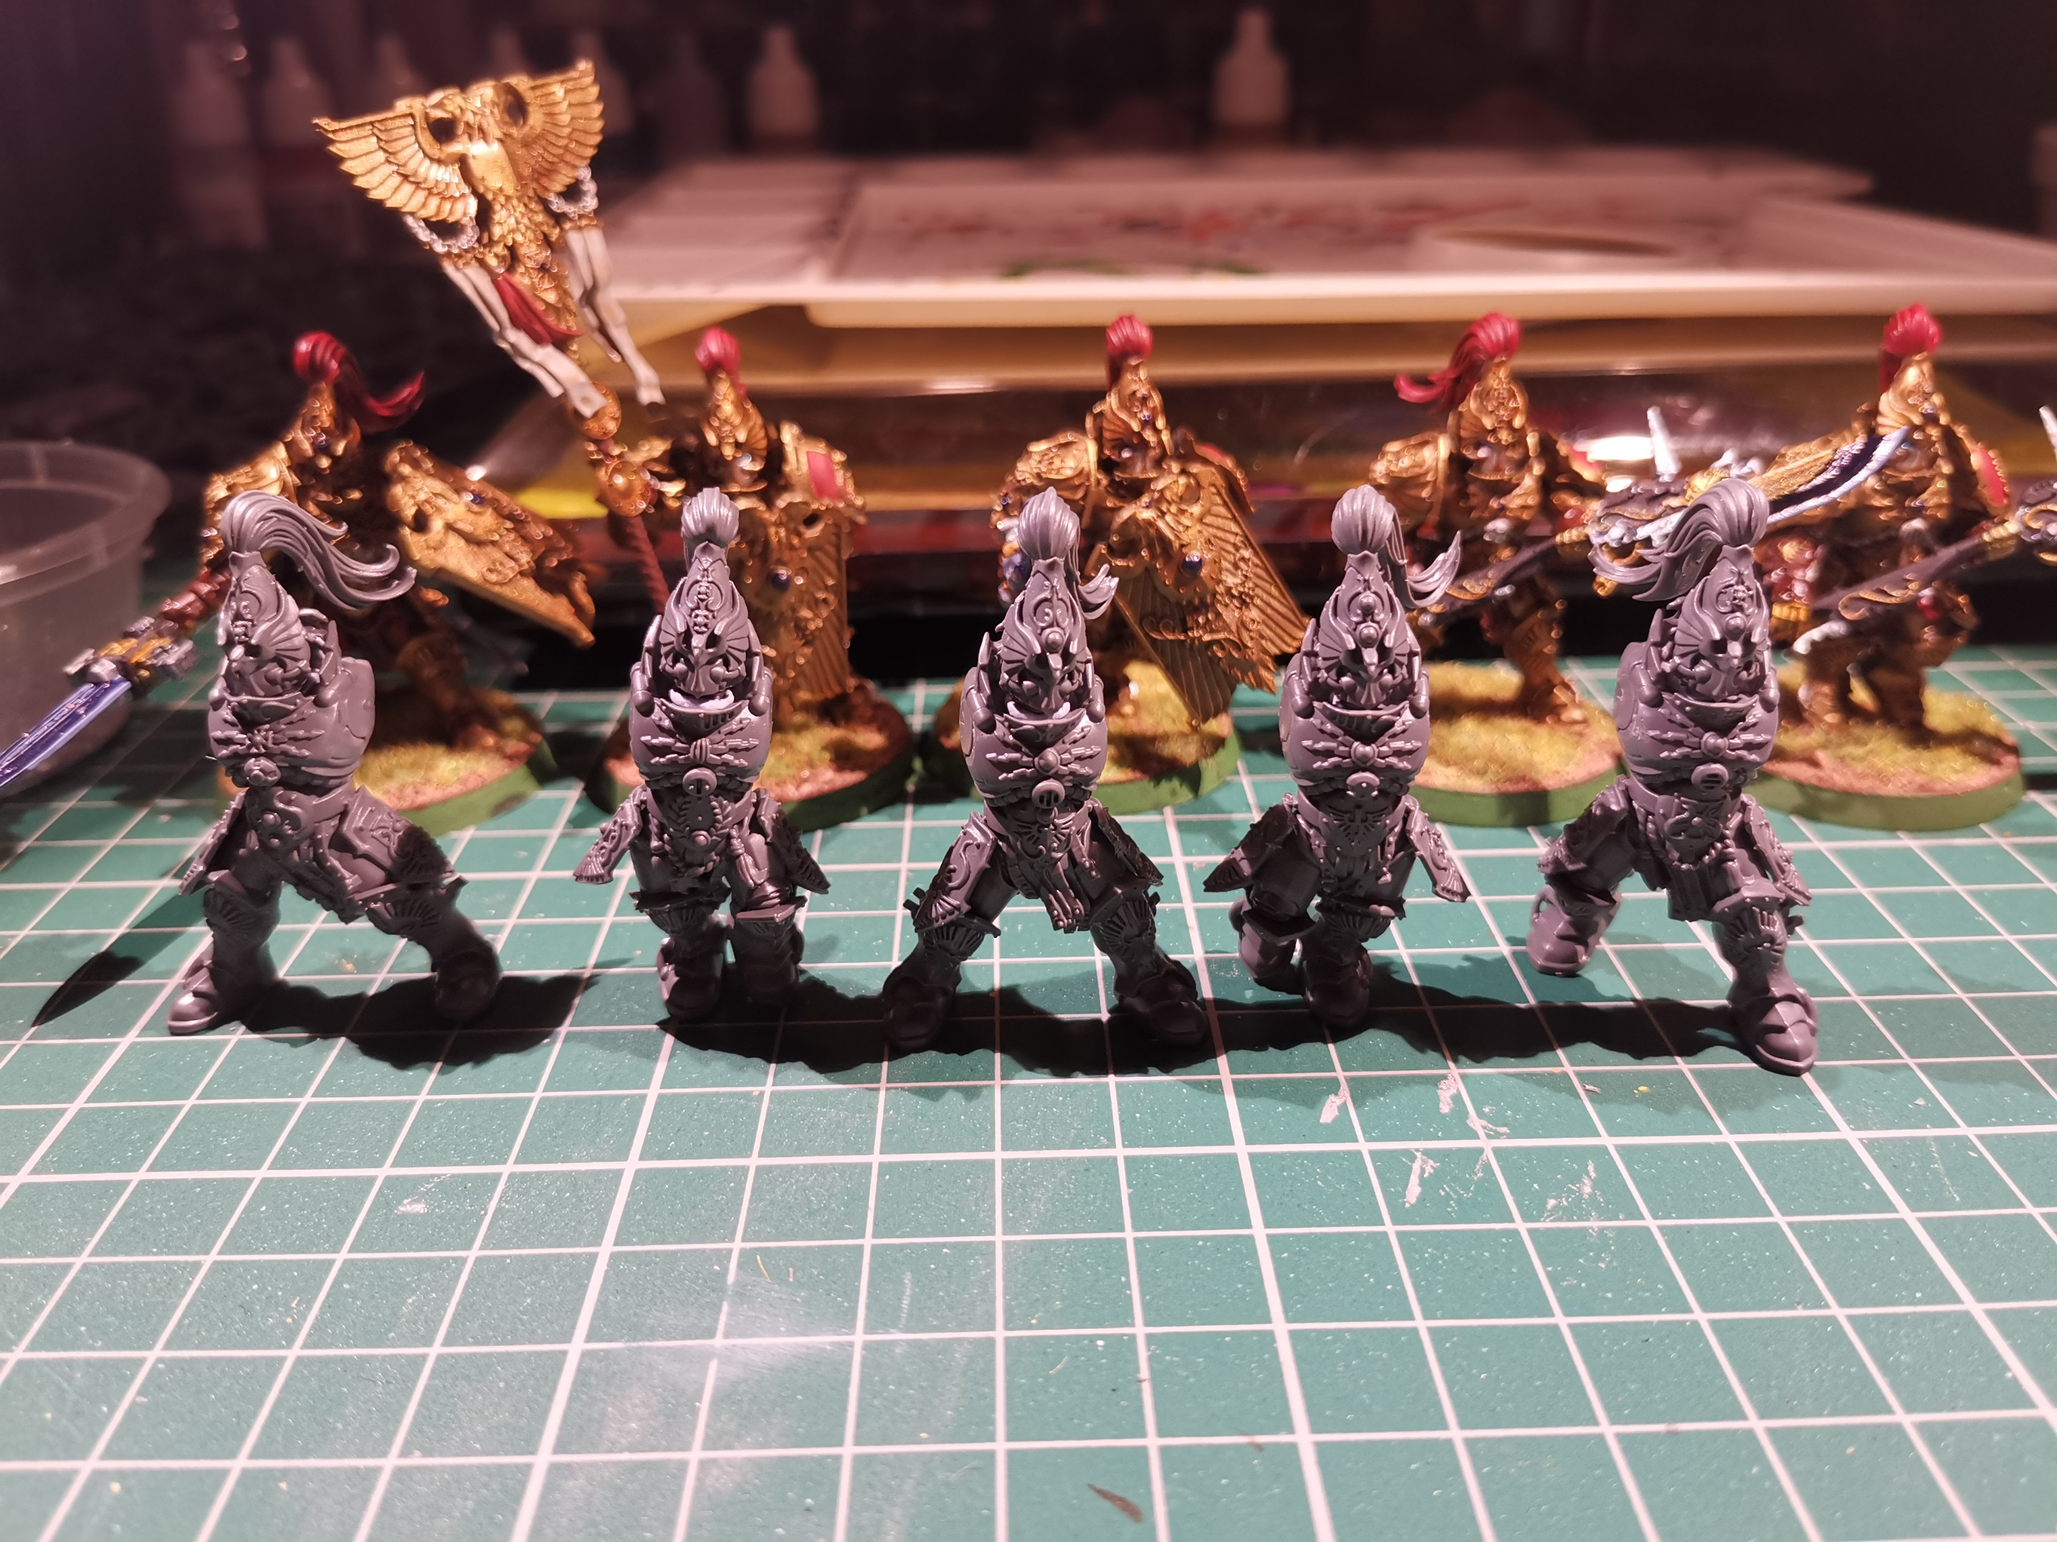
Building
Notes:
Buy a box
Sprue (sheet of plastic parts)
Like airfix or other model kits
Varying degrees of customisation
‘green stuff’ (epoxy putty) to sculpt on top

Slide 9
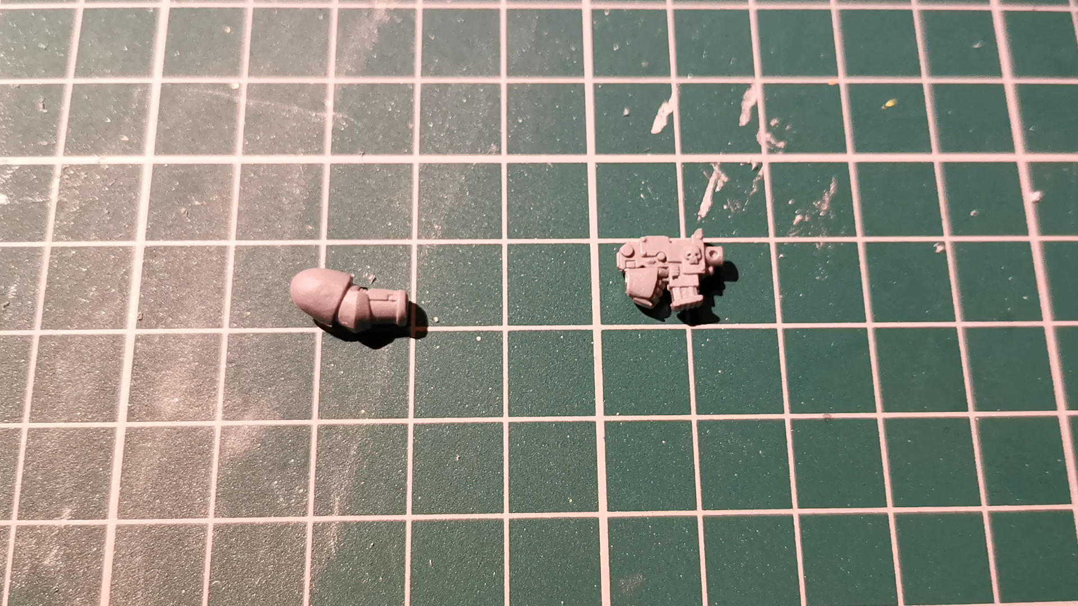
Building
Notes:
Some people go to great lengths to fan

Slide 10
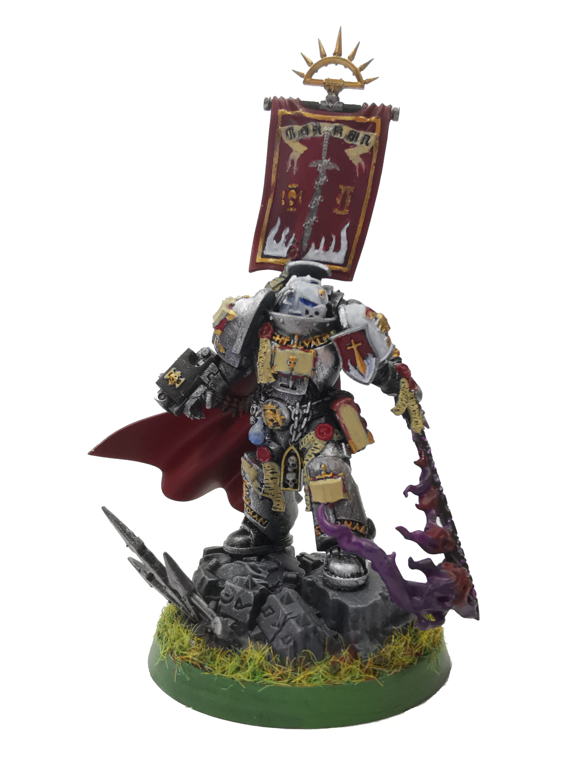
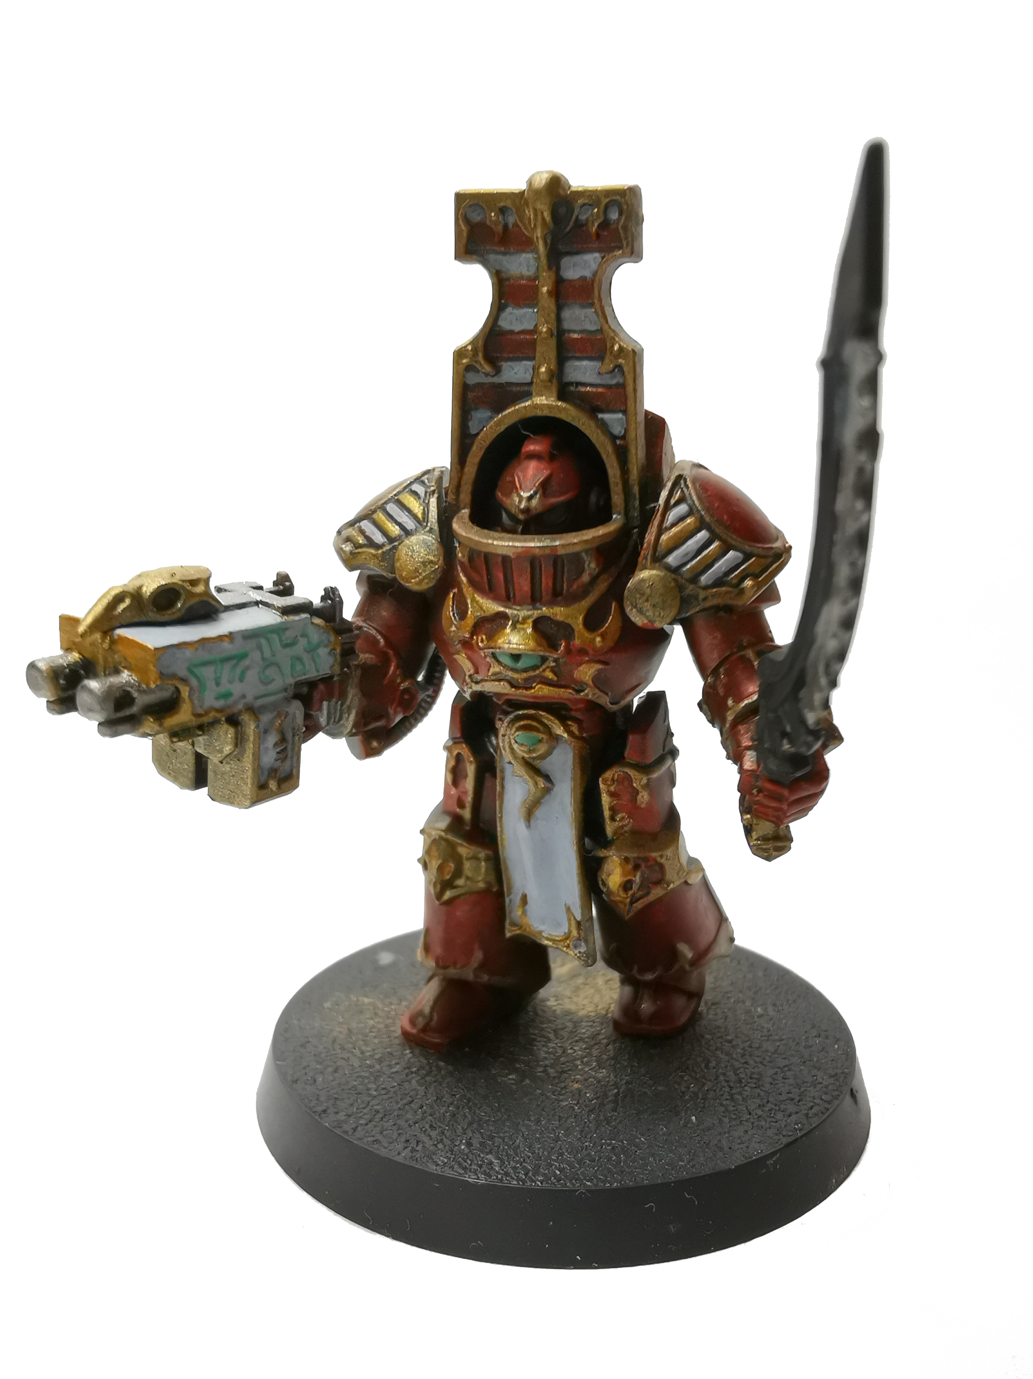
Painting

Slide 11
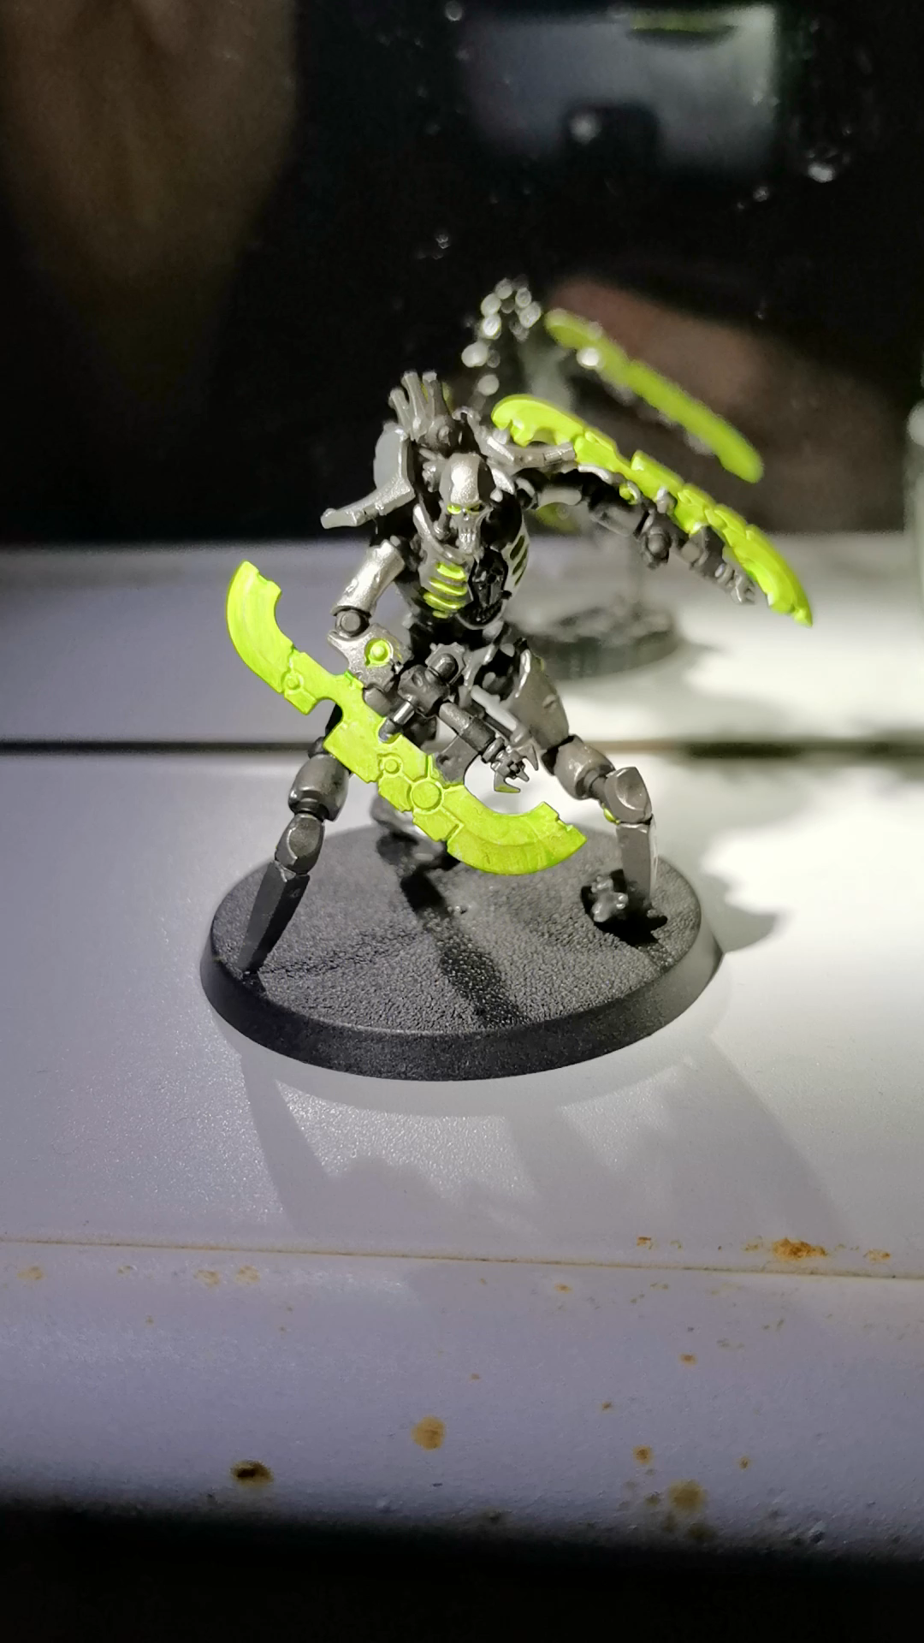
Painting

Slide 12
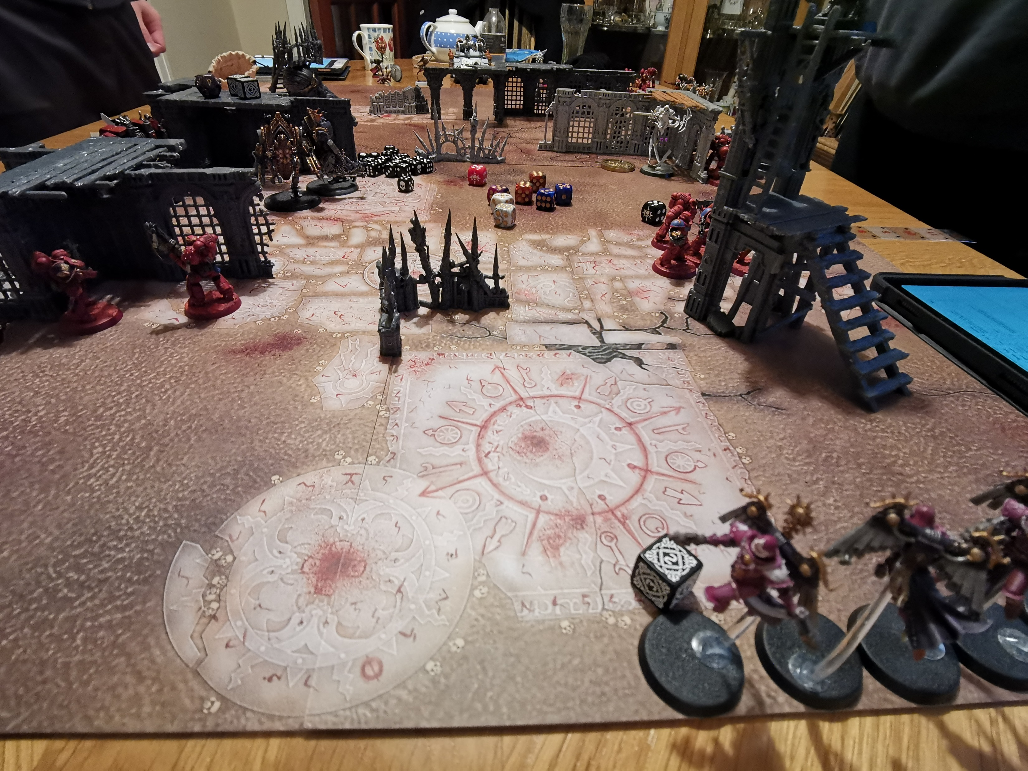
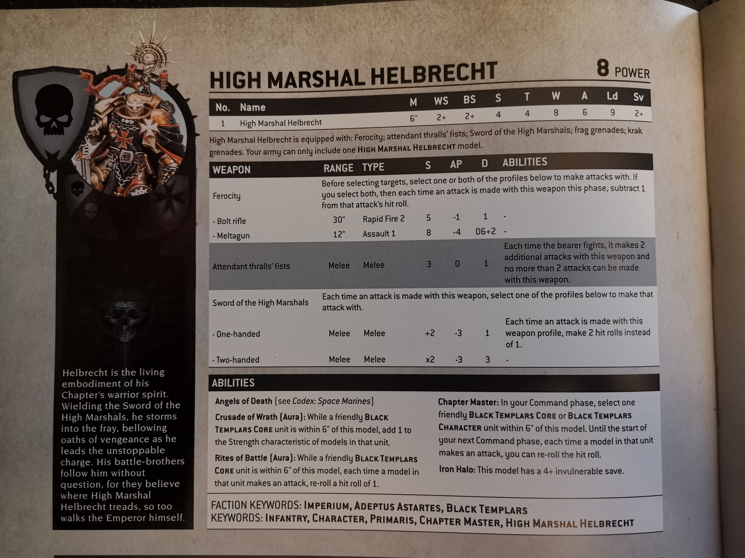
Playing
Notes:
Core Rules
Army Book
Selection of ‘Units’ with various pieces of ‘wargear’
Games played with a ‘power level’ or ‘points total’, have to make a list that fits in this size
9th edition has lots of special rules for each faction!
Pick a mission
Place terrain, armies
Take turns to move, use psychic powers, shoot, charge, fight, morale

Slide 13
Escaping the Digital
Computers are all consuming!
Analogue hobbies are a huge boon in current times
You might already have an excellent outlet hiding in your own history, just waiting to be dusted off!
Notes:
Computers are all consuming
Useful to have hobbies that don’t revolve around the PC
Creative endeavour at all points! 3 very nice hobbies for that

